Slide 1
Lab 5-A
Counter and 8 Bit Register
i. Counter
Design a 3 Bit Up Counter with Reset.
ii. 8 Bit Register
Design a 8 Bit Register which stores and outputs a 8 bit binary input on clock rising edge with ‘Low’ on Load Input.

Slide 2
Counter Design Example
Design a 3 bit up counter which counts 0,1,2,3,4.
Invalid states should go to 0
Hold at 4
0
1
4

Slide 3
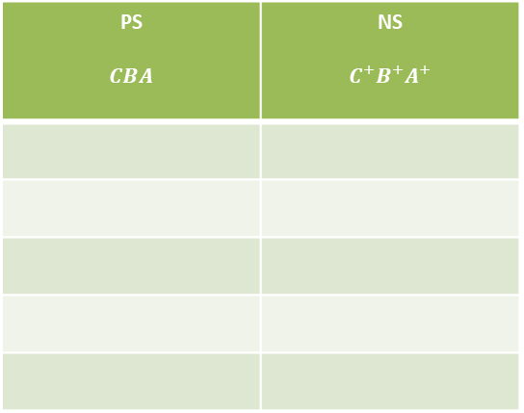





Counter Design Example
1. Complete the truth table for 3 bit up counter.
PS $$CBA$$ | NS $$C^{+}B^{+}A^{+}$$
2. Find the Boolean expression for $C^{+}B^{+}A^{+}$.
$$A^{+}=????$$
$$B^{+}=????$$
$$C^{+}=????$$
3. I$mplement { C}^{+}B^{+}A^{+}$.

Slide 4













Counter Block Diagram
$$Reset$$
Connect to the CLR of DFF.
Input
Output
Combinational Ckt
DFF A
$$A$$
$$A^{+}$$
$$A$$
$$\overline{A}$$
$$B^{+}$$
$$B$$
Output
$$B$$
DFF B
$$\overline{B}$$
From Flip Flip
$$C$$
$$C^{+}$$
DFF C
$$C$$
Output
$$\overline{C}$$
Give VCC to PRN.
Clock Input
In Quartus prime dff is a D flip-flop with a rising-edge trigger.

Slide 5
Simulate 3 Bit Counter Circuit
Run the 3 bit counter simulation.
Hint: when reset is zero the counter will reset.

Slide 6
A 8 bit Register Using Dff
A register is a storage or memory component in a digital ckt.
If (clock rising edge and LOAD = ‘0’)
Output = input;
Else
Output = Prev_Output;
End if;
clk
LOAD
Input
5
8
13
5
6
Output
5
8
8
8

Slide 7
Register using D Flip Flop
D | Clk | Q+
x | 0 | No change
1 | Rising Edge | 1
0 | Rising Edge | 0
D FF
Q
Din
Clk

Slide 8
Modified D Flip Flop
Modify D FF with an extra input: Load.
D | Clk | LOAD | Q+
x | 0 | 1 | No change
x | Rising Edge | 1 | No Change
1 | Rising Edge | 0 | 1
0 | Rising Edge | 0 | 0
Din
D FF
Q
D
Clk
And
Clk
1
0
0
Load

Slide 9
Modified D Flip Flop
Modify D FF with an extra input: Load.
D | Clk | LOAD | Q+
x | 0 | 1 | No change
x | Rising Edge | 1 | No Change
1 | Rising Edge | 0 | 1
0 | Rising Edge | 0 | 0
Din
D FF
Q
D
Clk
And
Clk
0
1
Load

Slide 10
8 Bit Register
A
QA
FFA
D
clk
AND
QB
B
FFB
AND
Clock Input
.
.
.
.
.
.
Load Input
Reset Input
Reset Input connect
to all CLR pin of FF.
H
QH
FFH
AND
Give VCC to PRN.

Slide 11
Register Block Diagram
LOAD Input
8 Bit Register
QA
QB
QC
QD
QE
QF
QG
QH
A
B
C
D
E
F
G
H
Data Inputs
Data Outputs
Clock Input
Reset

Slide 12
Simulate the 8 Bit Register
Hint: when reset is zero the register is clear.
when load ==0 and clock rising edge
Output = Current Input
when load ==1
output = Previous Input.

Slide 13
Simulation and Downloading
Simulation Waveform for Counter and 8 bit Register.
Download Counter Ckt to DE1 Board.

